Slide 1
Dummy Variables

Slide 2
Introduction
Discuss the use of dummy variables in Financial Econometrics.
Examine the issue of normality and the use of dummy variables to correct any problem
Show how dummy variables affect the regression
Assess the use of intercept and slope dummy variables

Slide 3
The Normality Assumption
In general we assume the error term is normally distributed.
Financial data often fails this assumption due to the volatile nature of the data and the numbers of outliers.
The normality of the error term can be tested using the Bera-Jarque test, which tests for the presence of skewness (non-symmetry) and kurtosis (fat tails)

Slide 4
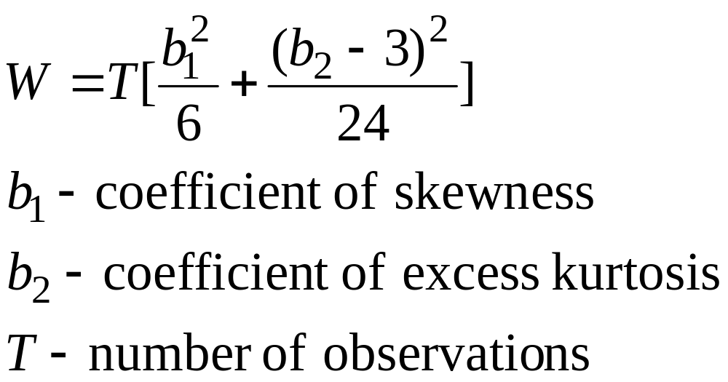
Bera-Jarque Test
This test for normality in effect tests for the coefficients of skewness and excess kurtosis being jointly equal to 0

Slide 5
Bera-Jarque Test
The statistic follows the chi-squared distribution with 2 degrees of freedom.
The null hypothesis is that the distribution is normal.
i.e. if we get a Bera-Jarque statistic of 4.78, the critical value is 5.99 (5%), then as 4.78<5.99 we would accept the null hypothesis that the error term is normally distributed.
Most computer programmes report this statistic.

Slide 6
Remedies for non-normality
The non-normality is often caused by a couple of observations in the tails of the distribution, these observations are often termed outliers.
The simplest way to solve the problem is to use a dummy variable, often called an impulse dummy variable, which takes the value of 0, except the one outlier observation which takes the value of 1.
This has the effect of forcing the residual for this observation to 0.
To determine where the outlier is, we could simply plot the residuals against time.

Slide 7
Non-normality
The use of this type of dummy variable is controversial, as some argue it is an artificial method of improving the regression, by in effect removing the influence of this particular observation.
However an outlier can have an excessively strong effect on a model, giving an unrealistic result, so needs to be taken into account.

Slide 8
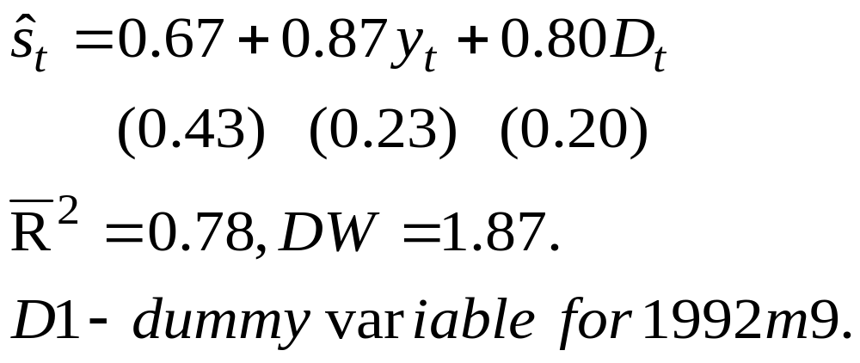
Dummy Variable for Single Outlier
In a regression of stock prices against income for the UK, an outlier was noticed for 1992 month 9, when the UK left the ERM. A dummy variable was added to account for this. This produced the following result:

Slide 9
Dummy Variables
The previous set of results can be interpreted in the usual way, in this case the dummy variable has a significant t-statistic (4), so the outlier has a significant effect on the regression, or put another way the UK leaving the ERM had a significant effect on UK stock prices.
In many cases however the outlier will be more difficult to interpret and may not correspond to a particular event.

Slide 10
Dummy Variables
Dummy variables are discrete variables taking a value of ‘0’ or ‘1’. They are often called ‘on’ ‘off’ variables, being ‘on’ when they are 1.
Dummy variables can be used either as explanatory variables or as the dependent variable.
When they act as the dependent variable there are specific problems with how the regression is interpreted, however when they act as explanatory variables they can be interpreted in the same way as other variables.

Slide 11
Types of Explanatory Dummy Variable
Qualitative dummy variables: i.e. age, sex, race, health.
Seasonal dummy variables: depends on the nature of the data, so quarterly data requires three dummy variables etc.
Dummy variables that represent a change in policy:
  Intercept dummy variables, that pick up a change in the intercept of the regression
  Slope dummy variables, that pick up a change in the slope of the regression

Slide 12
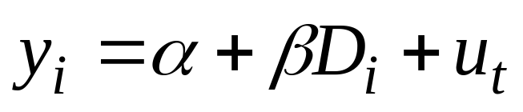
Dummy Variables
If y is a teachers salary and
  Di = 1 if a non-smoker
Di = 0 if a smoker
We can model this in the following way:

Slide 13
Dummy Variables
This produces an average salary for a smoker of E(y/Di =0) =α.
The average salary of a non-smoker will be E(y/Di = 1) = α + β.
This suggests that non-smokers receive a higher salary than smokers.

Slide 14
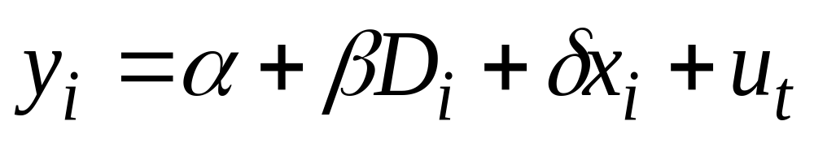
Dummy Variables
Equally we could have used the dummy variable in a model with other explanatory variables. In addition to the dummy variable we could also add years of experience (x), to give:

Slide 15
Dummy Variables
y
Non-smoker
Smoker
α+β
α
x

Slide 16
Seasonal Dummy Variables
The use of seasonal dummy variables is widespread in finance due to the ‘day of the week’ effect on asset prices.
They take the same format as other dummy variables, i.e. a January dummy variable would consist of 0, except every observation in January which has the value of 1.
For monthly data, we include 11 dummy variables, quarterly data 3 etc. i.e. we have as many dummies as months, quarters etc minus 1.
The excluded month acts as the reference category, i.e. all the other dummies refer to differences between themselves and this reference month.

Slide 17
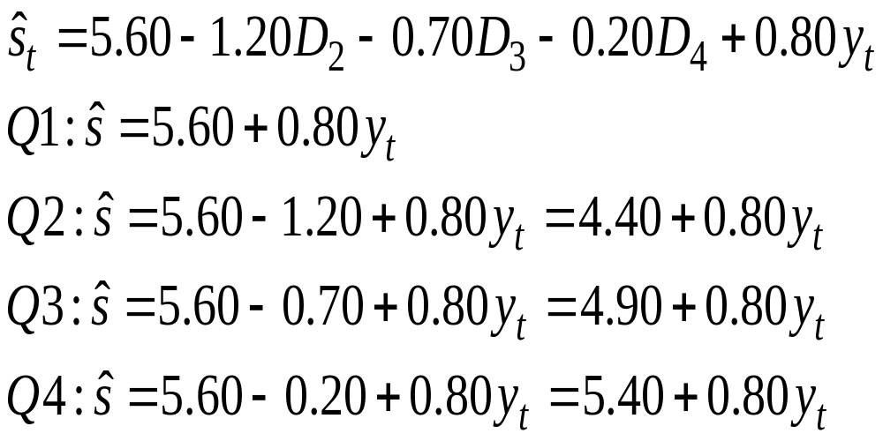
Seasonal Dummy variables
If we have the following model of share prices for a gas and electricity firm, where the share price is regressed against 3 dummy variables. (Using quarterly data)

Slide 18
Seasonal Dummy variables
The regression can not be carried out if all the seasonal dummies are added (i.e. 4 for quarterly data), as there is perfect multicollinearity
Although we can use the t-test to determine if the seasonal dummy is significant, we usually use an F-test to determine if they are jointly significant.

Slide 19
Slope Dummy Variables
The type of dummy variable considered so far is the intercept dummy variable, we could also use dummy variables to model changes in the slope of the regression line, these are known as slope or interaction dummy variables.
We can include either types of dummy variable or more commonly both types in a regression, to account for changes in the intercept and slope of the regression line.

Slide 20
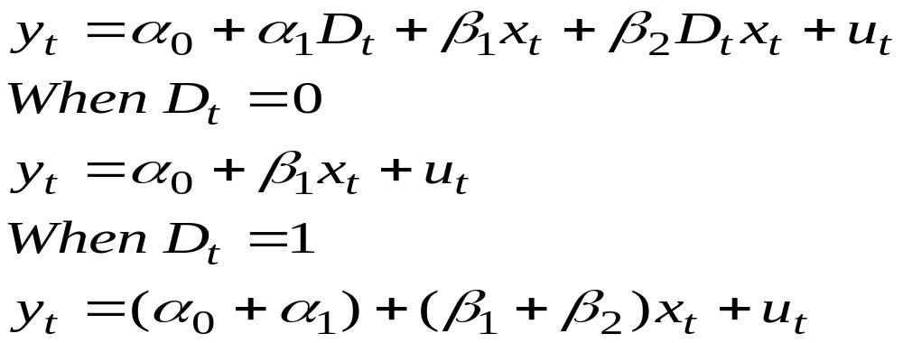
Slope Dummy Variables
The slope dummy variable consists of a term which is the product of an explanatory variable and dummy variable (Dx):

Slide 21
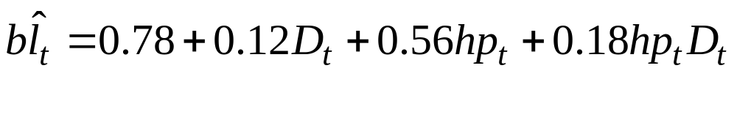
Slope Dummy Variable
Given the following results from a demand for bank loans (bl) model, with house prices (hp) as the explanatory variable. The dummy variable takes the value of 0 before 1979 and 1 afterwards. The slope dummy is going to determine the change in lending as a result of changes to the credit laws, i.e. it is easier to borrow based on the value of a persons house.

Slide 22

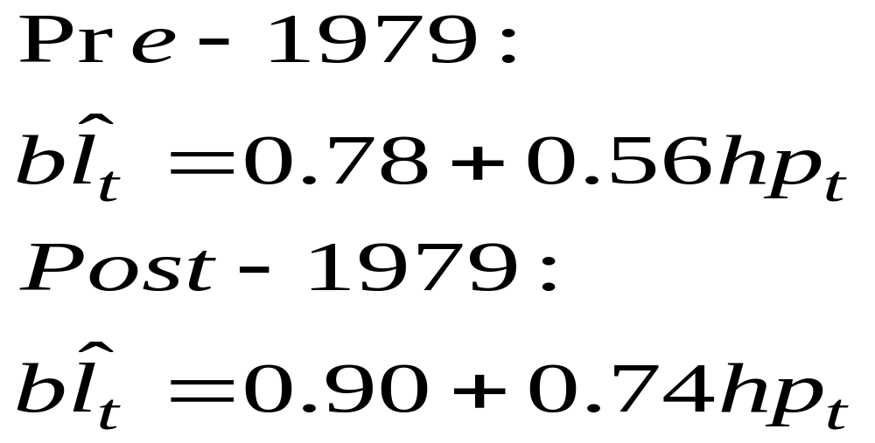
Slope Dummy variables
We then get two separate regression lines, before and after 1979, with different intercepts and slope coefficients:

Slide 23
Test for Structural Stability
Although the Chow test is usually used to test for a structural break, an alternative test involving the dummy variables can also be used.
It involves running two regressions, one with the dummy variables (unrestricted model) and collecting the RSS.
The other regression excludes the dummy variables (restricted model) and collect this RSS.
Use the F-test formula to produce the F-statistic and compare with the critical values, the null hypothesis being that the regression is structurally stable.

Slide 24
The Dummy Variable Approach to Testing for a Structural Break
Instead of two separate regressions on each sub-sample, as in the Chow test, we just need the single regression with the dummy variables (as well as without the dummy variables)
The dummy variable approach allows us to test a variety of hypotheses about any structural break
The dummy variable approach allows us to determine if it is the intercept or slope that is different
Using the Chow test requires testing of sub-samples, which reduces the degrees of freedom

Slide 25
Conclusion
When running a regression, we assume the error term is normally distributed
The Bera-Jarque test is used to determine if the error term is normally distributed.
To overcome non-normality, we can use an impulse dummy variable to account for any outliers.
Dummy variables have a variety of uses, mostly being used to model qualitative effects
Dummy variables can be in either intercept or slope form.

